Slide 1



SHORT-TERM INSURANCE

Slide 2






INSURANCE TOPICS THAT ARE RELEVANT TODAY
Personal Insurance
Cyber Crime
Climate Change
Commercial
Insurance
SASRIA
Professional Indemnity Cover

Slide 3








THE DIFFERENCE BETWEEN PERSONAL AND BUSINESS INSURANCE
OFFICE CONTENTS / HOUSEHOLD CONTENTS
COMMERCIAL LIABILITY / LIABILITY
COMMERCIAL BUILDINGS / BUILDINGS
ELECTRONIC EQUIPMENT
BUSINESS INTERRUPTION / COVID 19
ACCIDENTAL DAMAGE
BUSINESS ALL RISKS / ALL RISK
COMMERCIAL MOTOR / MOTOR
COMMERCIAL THEFT

Slide 4

CLIMATE CHANGE AND THE IMPACT ON YOUR BUSINESS
Recently climate change has become an alarming concern for Insurance companies.
In 2017 worldwide weather events ran up estimated losses of R4.8trn (Swiss Re Sigma).
Both locally and internationally climate change contributed to significant losses due to severe weather-related catastrophes
The Knysna fires estimated cost R4bn
Gauteng floods estimated cost R3bn
Drought in the Eastern and Western Cape
Recent flooding in Europe estimated at $1.2bn
Hurricane Harvey caused $125bn in damage in 2017
Australian Bush Fires $4.4bn

Slide 5

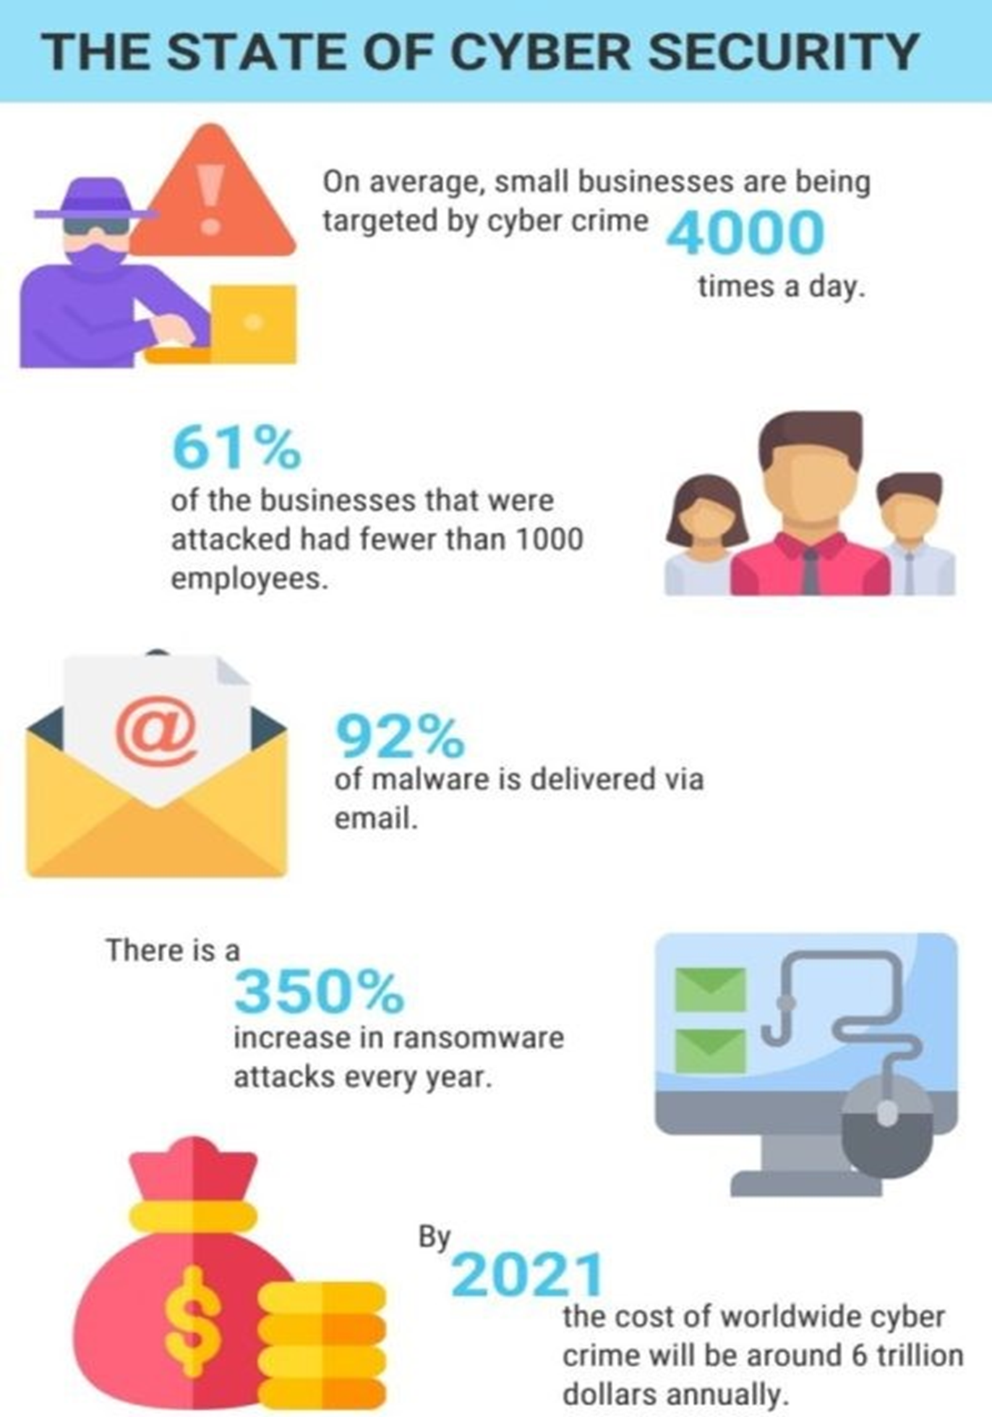
CYBER SECURITY

Slide 6
RISK ASSOCIATED WITH CYBER CRIME
reputational risk;
business interruption;
business continuity;
shareholders and customer confidence;
technology risk; and
regulatory scrutiny if you are in a regulated jurisdiction.

Slide 7
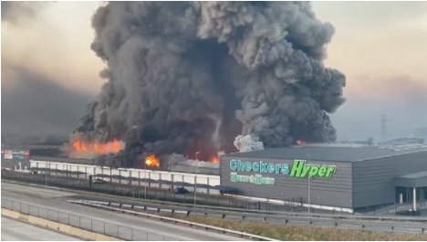

Brief overview sasria
SASRIA (South Africa Risk Insurance Association originated in 1976 after the civil disruption during a political time in South Africa
SASRIA is the only insurance company that provides cover for special risk such as political motivated acts, riots, strikes, terrorism and public disorders
SASRIA is a state-owned insurance company governed by the Minister of Finance and regulatory bodies of the insurance industry
SASRIA collected R2.4-Billion in premiums in 2020, 11% increase since 2019
Claims paid by SASRIA in 2020 equals to R992 million compared to R1.6-billion in the previous financial year
In 2020 SASRIA reported a profit of R333-million after tax
PPS Short-Term Insurance is an authorised Financial Services Provider No. 46274.

Slide 8
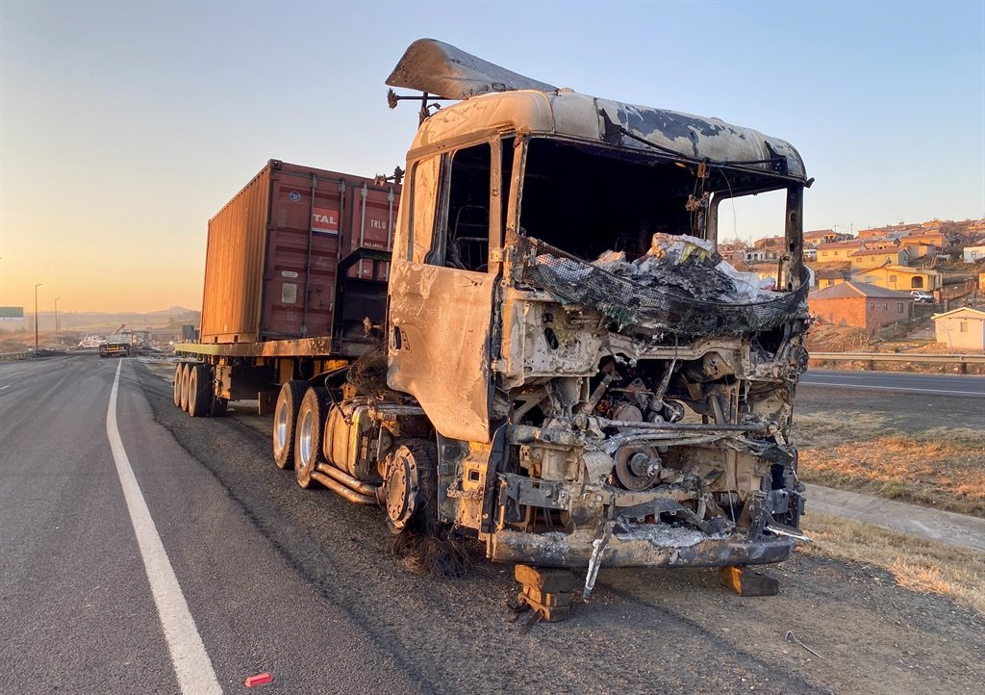
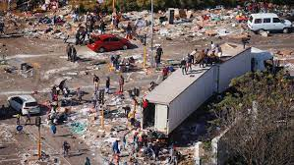
RIOTS AND STRIKES KZN/sasria
SASRIA Estimated claims cost is between R10-R30 Billion
What have we learned from the looting in KZN/Gauteng?
It is important to ensure that you are insured correctly and that you have the adequate covers in place
Many business still do not have insurance against these eventualities
Food for thought :
Do you have the correct cover in place?
What impact will this have to your business
What the impact to your client's business?
Think about the Supply Chain, harbors closed, not being able to transport basic goods and essentials
Claims adjusters are still counting the cost of damages
It is believed that over 200 shopping malls have been destroyed and 3000 shops
Government has committed to ensure that SASRIA is able to honor all valid claims
It is further believed that 40 000 business was impacted and 50 000 informal businesses

Slide 9
PROFESSIONAL indemnity insurance
PI cover is insurance designed to cover you against your clients after they might suffer a loss due to an act of omission or negligence caused by you.
Some points to consider when taking out this cover:
You need to identify how big is the balance sheet of your largest client
What fees do you charge
What services do you provide

Slide 10
ASK YOUR Broker / insurer
It is important to differentiate between Personal Insurance and Commercial Insurance to ensure that you are adequately covered:
Personal Lines Insurance (Your personal assets)
Commercial Insurance relevant covers and extensions that your business requires
SASRIA (sometimes brokers/insurers do not add SASRIA cover under CL policies for the benefit of the premium)
Specialised Insurance:
Professional Indemnity
Cyber Insurance
Remember to inform your broker/insurer of any material changes in your risk profile both personal and commercial for example:
change of address, adding or removing electronic item, driver details etc.
Speak to your broker at renewal stage to ensure that your values are updated on Buildings/Contents as this could impact you at claim stage due to under insurance.

Slide 11
THANK YOU
Notes:
The END (movie theme)

