Slide 1




Protecting Business Information from
Cyber Disaster
August 5th 2021
PRESENTED BY
Steve Jump

Slide 2




ABOUT THE PRESENTER
Steve Jump
Custodiet Advisory Services
Steve Jump consults, coaches, and advises in the field of Information Security Risk and Governance, where he expresses support, sympathy, incredulity and fortunately, frequent flashes of inspiration around the state of Information Security risk management in business today.
With over twenty years of practical and strategic information and cyber security experience Steve provides applied cyber security risk governance coaching, mentoring, and guidance at an Exco, Board and ISO level to ensure that non-technical and technical directors understand that information security risk is more about business success than about technology, and how that understanding enables the creation of business value.

Slide 3


TABLE OF CONTENTS
1
Understanding Risks that affect your business information
Know what information systems your business needs to operate 2
2
3
Building Cyber Resilience into the Basics

Slide 4


1. Understanding Risks that affect your business information
1

Slide 5

Business Risks are complicated
What Risks does your risk register contain?
What does your business continuity plan cover?
Digitalisation Risk
Technology Risk
Corruption/Fraud Risk
Notes:
5
The world has digitized –
Cheques are no longer legal tender
Quotations are online or via email
Invoices are paid by EFT
Almost ever business function is represented by data within an IT system
How reliable is your IT? How up to date? How well maintained? How resilient?
How fraud proof are your systems?

Slide 6
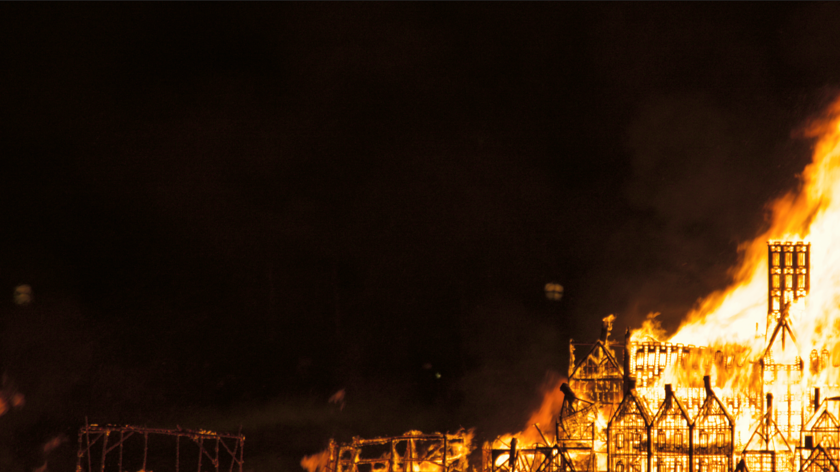
How do Cyber Threats affect your plans?
Information threats are
Environmental, Accidental, and Adversarial
Keeping IT systems available is hard
Laptops, databases, ERP, CRM, need constant
attention and update (Accident, oversight, error?)
Cyber Threats are Adversarial
Deliberate malicious attacks on your systems
Targeted or opportunist
Notes:
6

Slide 7

Cyber Risk is NOT an IT thing – It is a business Risk
Cyber threats are targeted at your business
Cyber Dependent Crime
  exploiting technical vulnerabilities to
  breach, steal data, ransom data, destroy data
Cyber Enabled Crime
  exploiting technical vulnerabilities to
  commit fraud, engage in economic crime,
  steal goods and services
Notes:
Since this is a disaster management conference we are looking at events that can destroy or irreversibly damage our businesses unless we take action.
Cyber Threats can bankrupt you, and lose all of your customers.

Slide 8

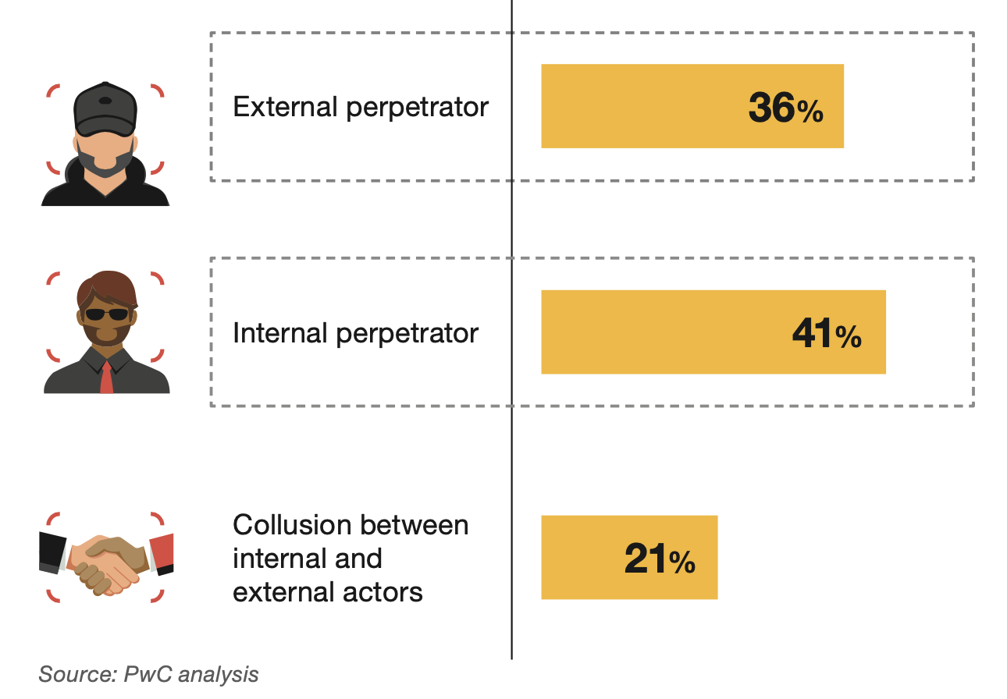
Cyber Enabled Crime begins at home
Actors that perpetrate economic crime in South Africa

Slide 9
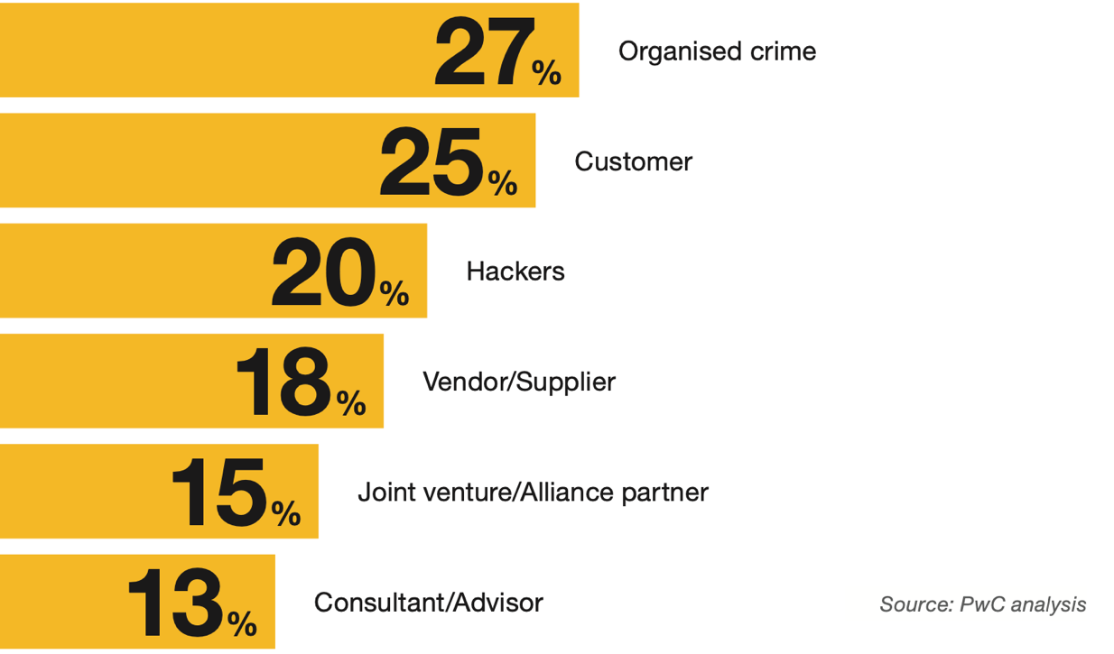
Cyber Enabled Crime is real
External Perpetrators of Economic Crime in South Africa

Slide 10

Do You have a cyber incident plan?
What is the largest risk that affect your organization?
What would it cost if it happened?
Do you have a disaster plan?
How would an active
cyber incident
affect your plan?
Cybersecurity PLAN
Notes:
10

Slide 11
2. Know what information systems your business needs to run
2

Slide 12
Know what Information Systems
your business needs to run!
Understand who needs what info and from which system.
Recognise how the data behind the systems can be affected.
What is the minimum data you can operate with? And How will you use it?
Notes:
12
Understand your systems.
Make a list - see what happens if you turn off any one of the systems
What happens if any one system has incorrect data – or if that data is corrupted?

Slide 13
3. Building Cyber Resilience into the basics
3

Slide 14

Do you have a Backup plan?
Is your backup date validated daily?
Is your backup off-site/cloud based?
Is your backup protected as if it was live?
Do you have multiple, separate backups?
Are they all protected against malware attack?
Where will you restore your working data to?
Do your users know how to connect?
Notes:
14

Slide 15

How do your users connect?
Have you tested their connection methods?
Can your help desk manage disaster support?
Do you know if they are your users?
Does your multi-factor authentication work?
Does your user validation and security work?
Notes:
15

Slide 16

Cyber Resilience is built on
Reliable, well maintained IT
Securely designed applications
Well managed and tested backups
Well trained and rehearsed staff
Security systems that prioritise business

Slide 17
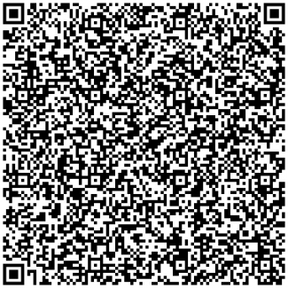


QUESTIONS & ANSWERS
Email questions to:
steve@custodiet.co.za

Slide 18


THANK YOU
For joining us.
Stay In touch.
Browse
Visit
Say Hello
www.saiba.org.za
The Workspace, Cnr Pinaster Avenue and, 18th St, Hazelwood, Pretoria
+27 12 643 1800

